Slide 1


Pierce County Real-estate Price Analysis
Final Presentation
Team Ames:
Ankita, Lili, Shuai, Walt

Slide 2

Problem Statement
1

Slide 3
The exploration of influential factors on residential property price using data mining algorithms
-- The study of real estate market of Piercy County, Washington

Slide 4
Literature Review
2

Slide 5
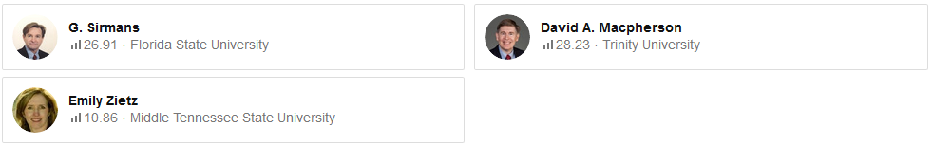
Literature Review
Sirmans, G. S., Macpherson, D. A., & Zietz, E. N. (2005). The composition of hedonic pricing models. Journal of Real Estate Literature, 13(1), 3-43.
Review approximately 125 real estate market studies from 1995 to 2005 and summarizes the top selected features in hedonic price model.

Slide 6
Literature Review
Hedonic Model
(Sirmans, Macpherson, & Zietz, 2005)
$$Price=f(Physical Characters , Other Factors)$$
Floor Area
Air-conditioner
Pool
Garage
Fireplace
Etc.
Location
School’s quality
Golf course
Neighborhood Education Level
Etc.

Slide 7
Literature Review
Top Selected Features
Eight categories of selected features
Lot Size | log(Lot Size) | House Square Feet | log(House Square Feet) | Brick | Age | Number of Stories | Number of Bathrooms| Number of Bedrooms | Full Baths | Fireplace | Air-Conditioning | Basement | Garage Space | Deck | Pool | Distance | Time on the Market | Time Trend.
Construction & Structure | House Internal Features, House External Amenities | Environmental – Nature | Environmental – Neighborhood & Location | Environmental – Public Service | Marketing | Occupancy & Selling | and Financial Issue

Slide 8
Data Processing
3

Slide 9
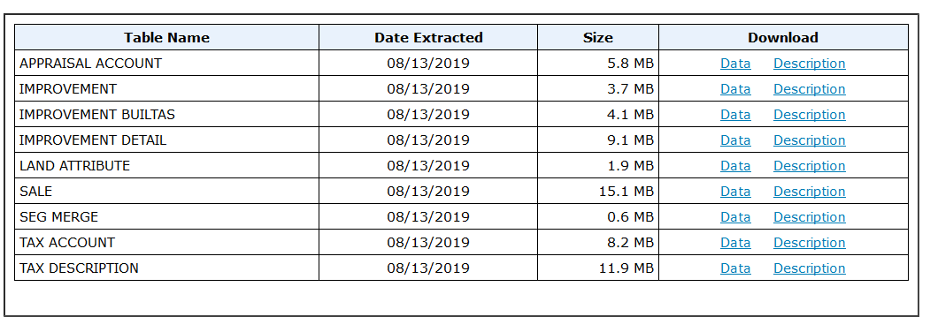

Data Processing
Data Source:
Pierce County Treasury Data Warehouse
Pierce County GeoSpatial Data Portal

Slide 10
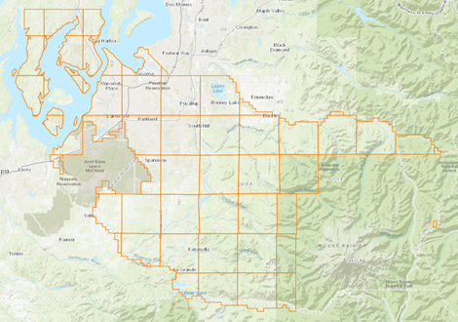
Data Processing
Data Description:
Spatial Boundary: Peirce County

Slide 11
Data Processing
Data Description:
Data set | Date Range
Appraisal Account (based on “appraisal date”) | 2011-09-12 ~ 2019-06-25
Seg merge (based on the “completed date”) | 1991-07-11 ~ 2019-06-12
Tax Account | Up to 2019
Tax Description | Up to 2019
Improvement | Up to 2019
Improvement Builtas (based on “year built”) | 1861 ~ 2019
Improvement Details | Up to 2019
Land Attribute | Up to 2019
Sale (based on “sale date”) | 1997-01-01 ~ 2019-06-04
Crime | 2018-06-01 ~ 2019-05-31
GIS Data | Up to 2019
Date Rage: Most data are up to 2019
Assumption to crime data:
Crime number of 2018 is same with the crime number of the time frame of mid 2018 to mid 2019
Jan 2018
Dec 2018
=
Jun 2018
Jun 2019

Slide 12
Data Processing
Data Description:
Table | Columns/Fields | Rows | Flat File Size
Appraisal Account | 24 | 331342 | 58.5 MB
Seg merge | 6 | 170439 | 6.9 MB
Tax Account | 28 | 328297 | 55.8 MB
Tax Description | 3 | 5199 | 78.0 MB
Improvement | 25 | 346979 | 38.1 MB
Improvement Builtas | 26 | 344252 | 42.9 MB
Improvement Details | 5 | 228644 | 93.8 MB
Land Attribute | 3 | 552542 | 21.7 MB
Sale | 12 | 524625 | 65.5 MB
Crime | 3 | 39 | 7.92 KB
GIS Data | 12 | 13587 | 483 KB
Date Size: Improvement Details is the largest data set

Slide 13
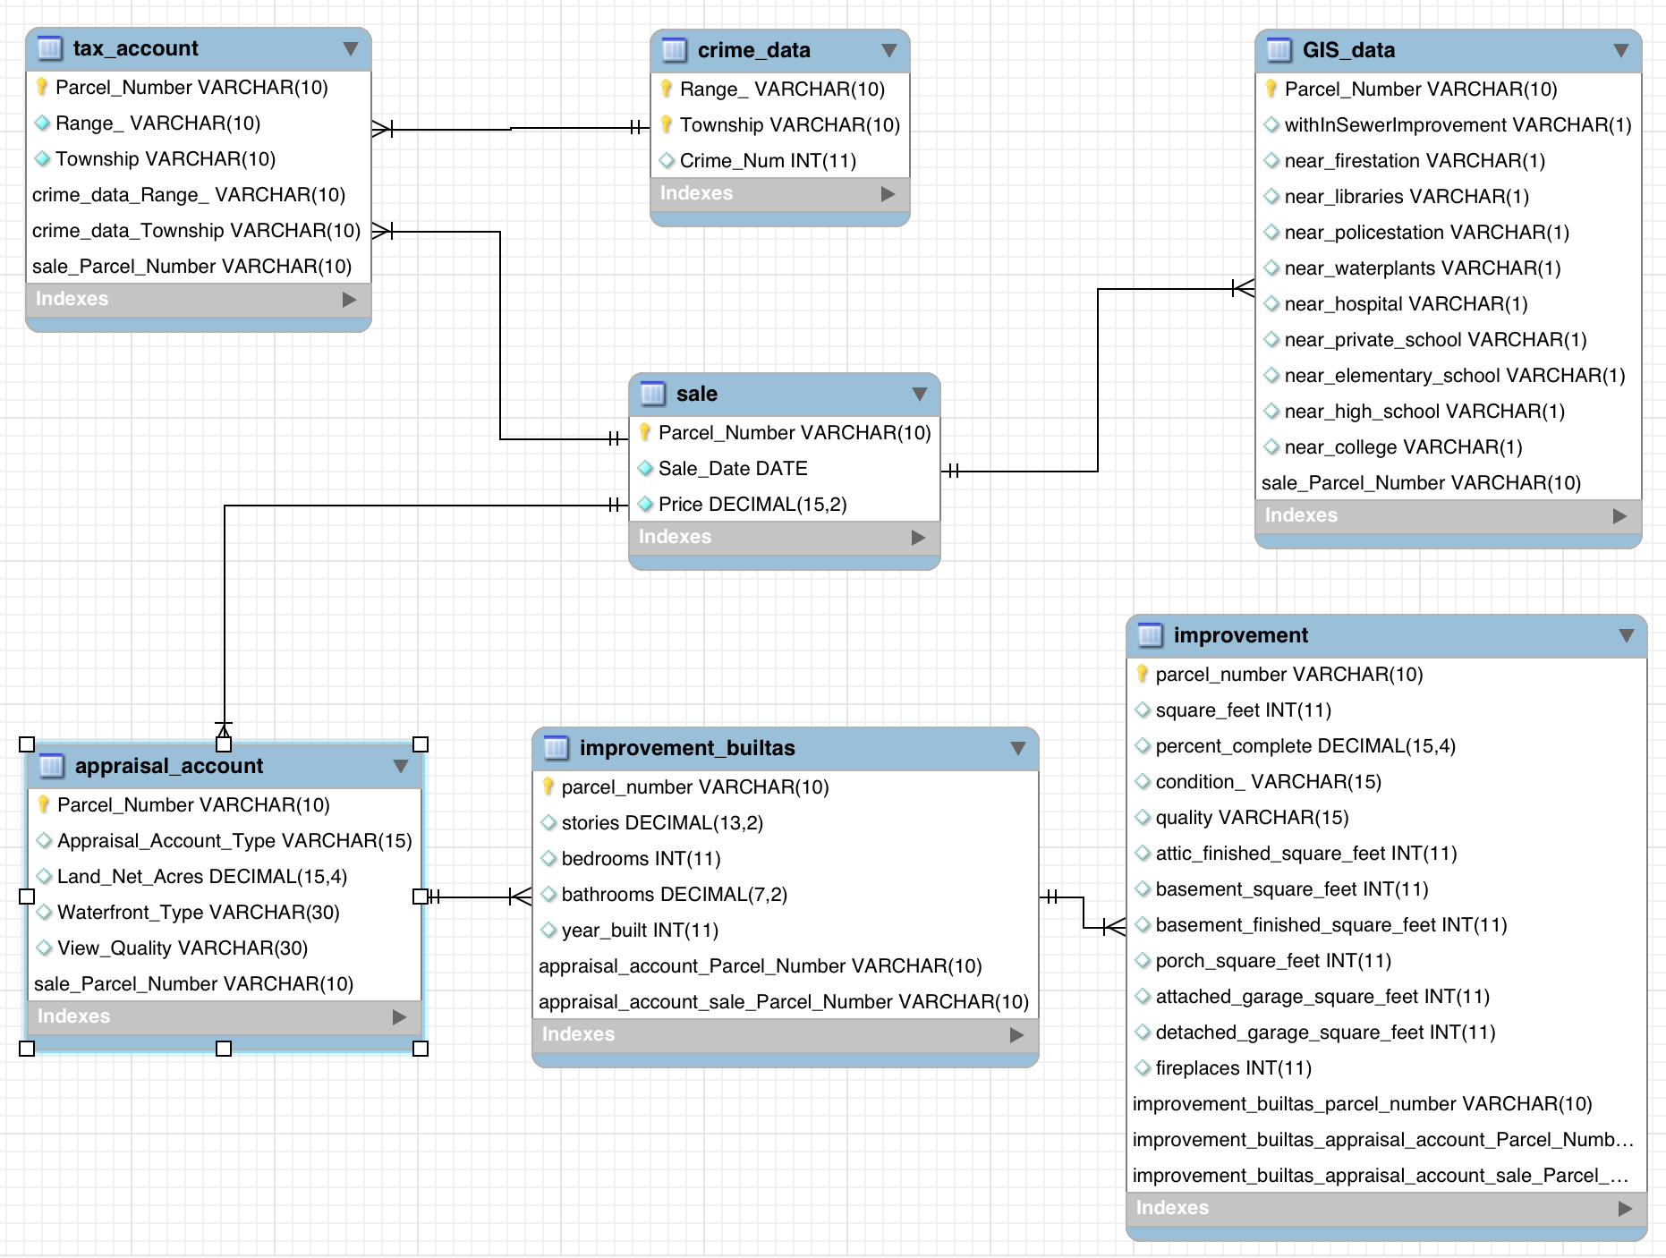
Data Processing
Data Description:
Date Size: Improvement Details
Central Table

Slide 14
Data Processing
Pierce County Treasury Data Warehouse
Pierce County GIS Database
Process in SQL Server
Process in ArcGIS
Import to SQL Server
Import to ArcGIS
Feature Selection in SQL Server
Spatial Selection and Statistical Summary in ArcGIS
Build the Master Dataset
Process in R
Data Cleaning in R
Final Master Table in R

Slide 15
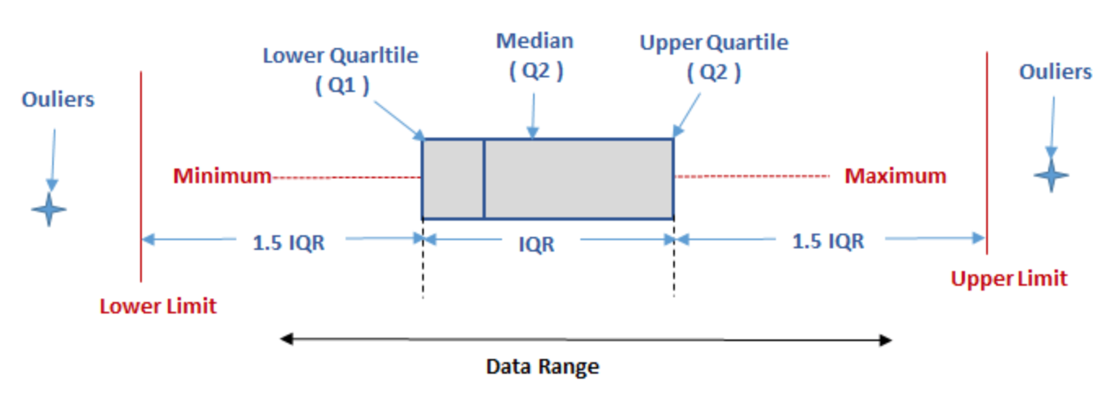
Data Processing
Outliers and Missing Values:
Variables with majority NULL dropped
Fireplace, Attic, Basement, Garage assumed to be 0
IQR Rule for Outliers applied to Price, Square Feet, Land Size, Bedrooms, Bathrooms, Stories, and Fireplaces

Slide 16
Models and Methodologies
4

Slide 17
Methodology
Piercy County Treasury Data
Feature Selection
Piercy County GIS Data
Feature Selection
Model 1
Feature Selection
Model 2
Clustering – Hierarchy
Clustering – K-Means
Full Data
Cluster 1
Cluster 2
Cluster 3
Decision Tree
Decision Tree
Decision Tree
Decision Tree
Random Forest
Random Forest
Random Forest
Random Forest
Neural Networks 1
Neural Networks 1
Neural Networks 1
Neural Networks 1
Neural Networks 2
Neural Networks 2
Neural Networks 2
Neural Networks 2

Slide 18
Modeling
Model 1:
Sale Price ~ Land Area + View Quality + Waterfront + Square Feet + Condition + Quality + Attic + Basement + Basement Finished + Porch + Attached Garage + Detached Garage + Fireplaces + Stories + Bedrooms + Bathrooms + Year Built (+ Hospital + Private School + Elementary School + High School + College + In Sewer Improvement + Fire Station + Library + Police Station + Water Plants)
(Treasury Data + Additional Data)
Hospital : 10 miles radius
Private School, Elementary School, High School, College : 3 miles radius
Fire Station , Library, Police Station, Water Plants: 1-mile radius
In Sewer Improvement: with in the area

Slide 19
Modeling
Model 2:
Sale Price ~ Land Area + View Quality + Waterfront + Square Feet + Condition + Quality + Attic + Basement + Basement Finished + Porch + Attached Garage + Detached Garage + Fireplaces + Stories + Bedrooms + Bathrooms + Year Built
(+ Hospital + Private School + Elementary School + High School + College + In Sewer Improvement + Fire Station + Library + Police Station + Water Plants)
(Treasury Data)

Slide 20
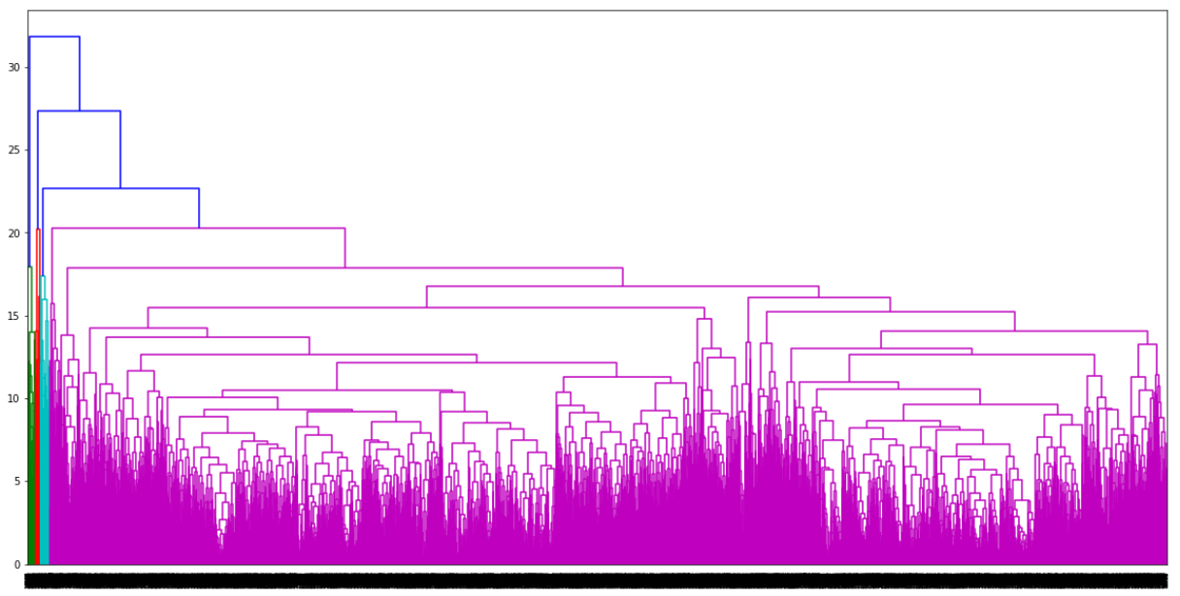
Clustering
Hierarchy – Complete
Hierarchy – Average
K - Means

Slide 21
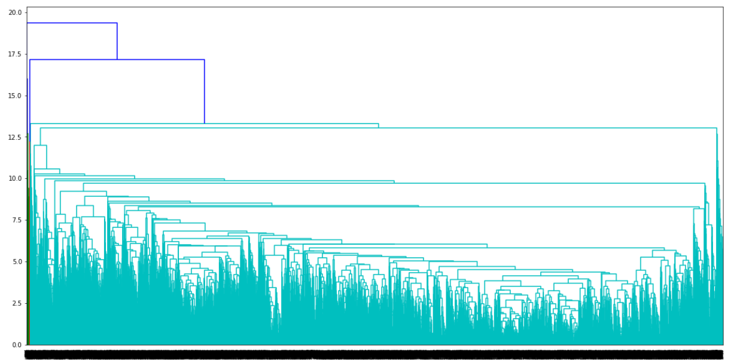
Clustering
Hierarchy – Complete
Hierarchy – Average
K - Means

Slide 22
Clustering
Hierarchy – Complete
Hierarchy – Average
K - Means

Slide 23
Models Comparison
5

Slide 24
Decision Tree
Dependent variable: Housing sales price in 2018 | Full Model Predictors: Both intrinsic and external features |  | MAPE | RMSE
 | Model (1) | Full Dataset | 18.55% | 75,311.15
 | Model (2) | Full Dataset with 3 clusters | 20.10% | 78,522.33
 | Model (3) | Full Dataset with 5 clusters | 20.44% | 77,048.04
 | Reduced Model Predictors: Only intrinsic features |  | MAPE | RMSE
 | Model (4) | Partial Dataset | 18.68% | 76,238.63
 | Model (5) | Partial Dataset with 3 clusters | 20.70% | 80,667.04
 | Model (6) | Partial Dataset with 5 clusters | 21.05% | 80,287.79
Best performance:
Model (1)
Conclusion:
No improvement with Clustering
Model improved with external attributes from GIS

Slide 25
Artificial Neural Network
Dependent variable: Housing sale price in 2018 | Normalized data |  | Hidden Layer =1 |  | Hidden Layer =2
 | Full Model Predictors: Both intrinsic and external features |  | MAPE | RMSE | MAPE | RMSE
 | Model (1) | Full Dataset | 23.32% | 85,203.68 | 24.45% | 82,428.85
 | Model (2) | Full Dataset with 3 clusters | 27.84% | 92,273.46 | 28.06% | 98,678.17
 | Model (3) | Full Dataset with 5 clusters | 23.07% | 83,246.44 | 30.99% | 118,830.79
 | Reduced Model Predictors: Only intrinsic features |  | MAPE | RMSE | MAPE | RMSE
 | Model (4) | Partial Dataset | 23.20% | 80,442.80 | 22.66% | 75,099.24
 | Model (5) | Partial Dataset with 3 clusters | 22.78% | 90,041.37 | 30.91% | 128,147.74
 | Model (6) | Partial Dataset with 5 clusters | 26.27% | 94,074.93 | 21.78% | 117,135.82
Best performance:
Model (4)
Conclusion:
No improvement with Clustering
Slight improvement with external features from GIS

Slide 26
Model Comparison
Dependent variable: Housing sale price in 2018 | Full Model Predictors: Both intrinsic and external features |  | MAPE | RMSE
 | Decision Tree | Model 1 | 18.55% | 75,311.15
 | Random Forest | Model 1 | 14.04% | 55,910.26
 | Neural Network | Model 1 (One Hidden Layer) | 29.84% | 123,443.38
 | Reduced Model Predictors: Only intrinsic features |  | MAPE | RMSE
 | Decision Tree | Model 4 | 18.68% | 76,238.63
 | Random Forest | Model 4 | 16.96% | 65,209.82
 | Neural Network | Model 4 (One Hidden Layer) | 29.12% | 133,580.48
Best performance:
Random Forest Full Model
Conclusion:
Model improved with external attributes from GIS

Slide 27
Random Forest
Dependent variable: Housing sale price in 2018 | Full Model Predictors: Both intrinsic and external features |  | MAPE | RMSE
 | Model (1) | Full Dataset | 14.04% | 55,910.26
 | Model (2) | Full Dataset with 3 clusters | 15.05% | 59,270.70
 | Model (3) | Full Dataset with 5 clusters | 14.19% | 58,737.94
 | Reduced Model Predictors: Only intrinsic features |  | MAPE | RMSE
 | Model (4) | Partial Dataset | 16.96% | 65,209.82
 | Model (5) | Partial Dataset with 3 clusters | 18.24% | 68,619.58
 | Model (6) | Partial Dataset with 5 clusters | 17.46% | 65,740.20
Best performance:
Model (1)
Conclusion:
No improvement with Clustering
Model improved with external attributes from GIS

Slide 28
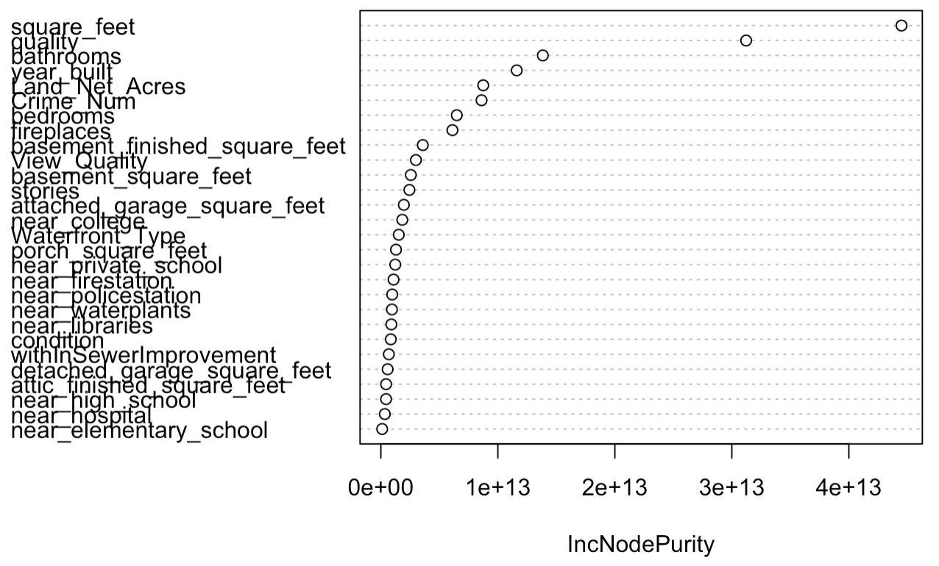
Random Forest- Feature Importance
Significant
Less
Significant

Slide 29
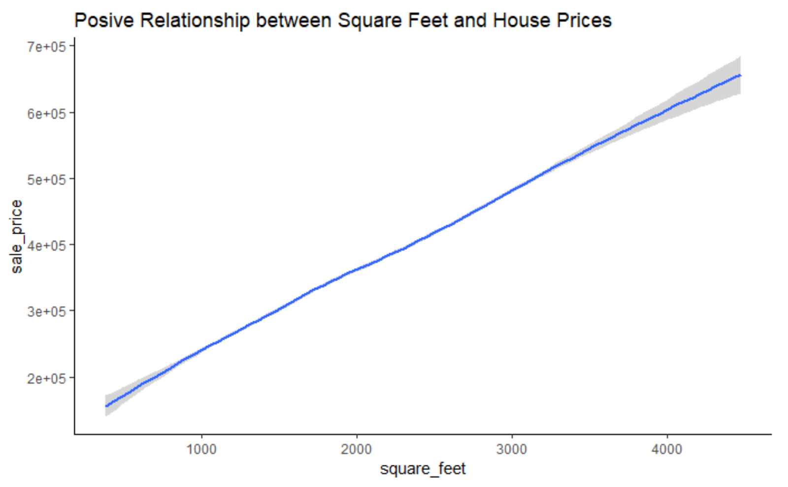
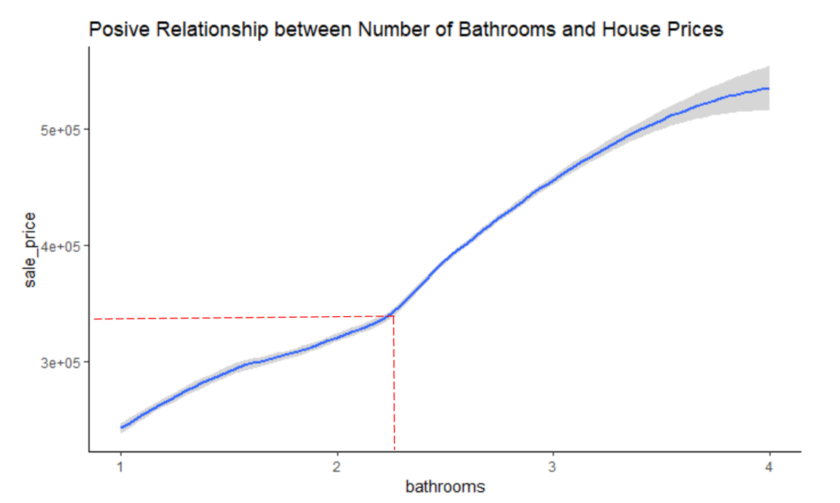
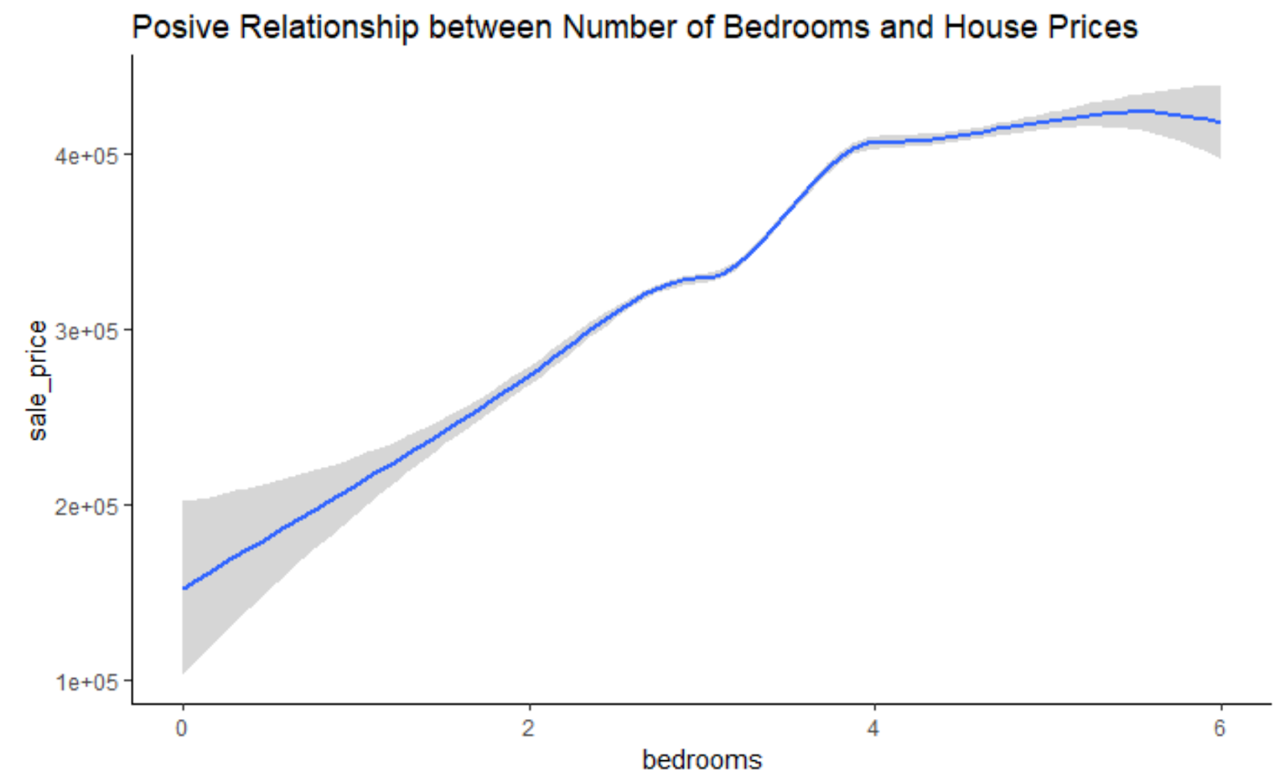
Space and Rooms
Square feet
Conclusion:
All have positive relationship with house prices
Bathrooms
Bedrooms

Slide 30
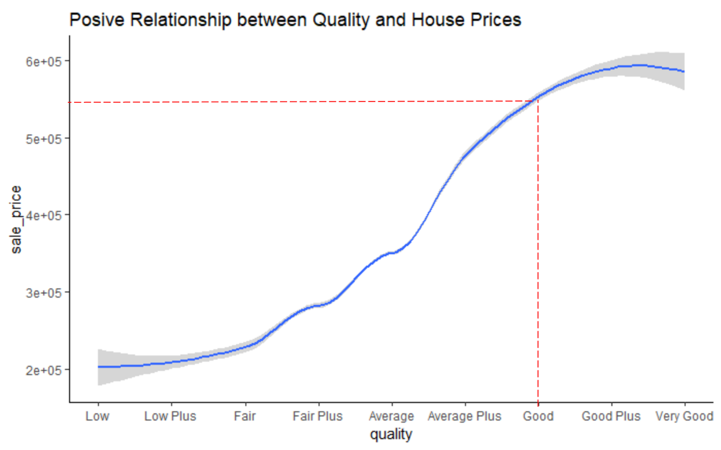
Quality
Conclusion:
Quality has positive
impact on house prices

Slide 31
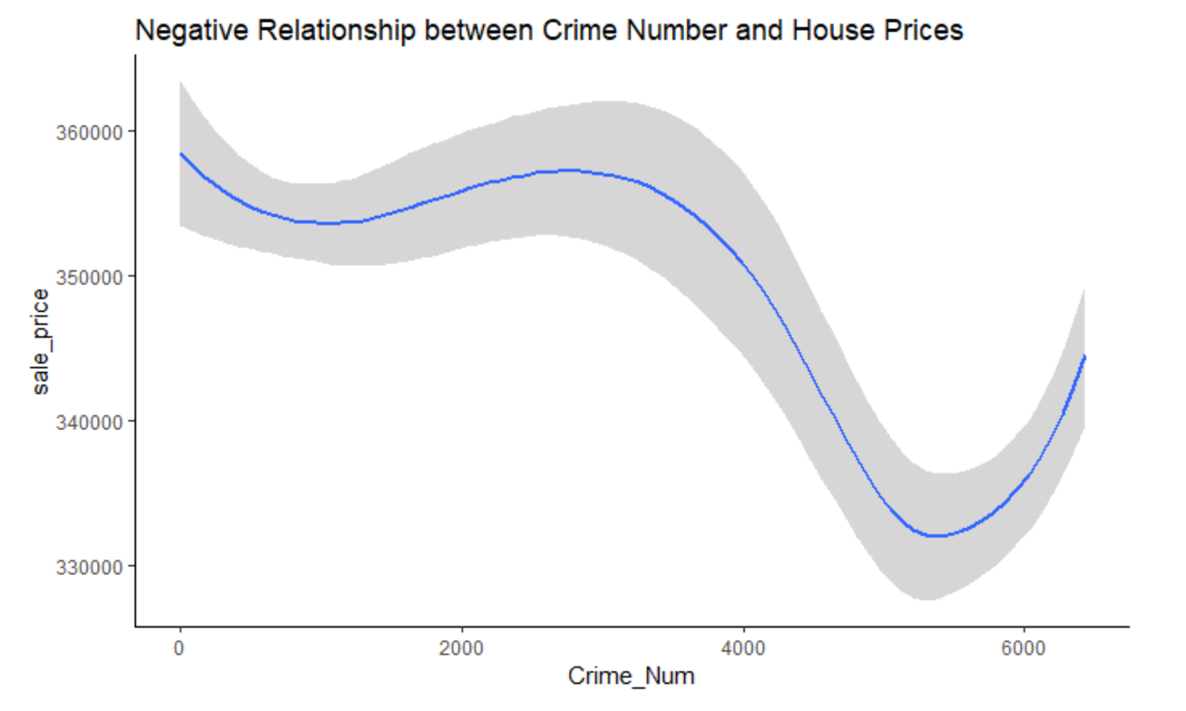
Crime Number
Conclusion:
Crime number has apparently negative impact on house price if annual crime number is over 4000

Slide 32
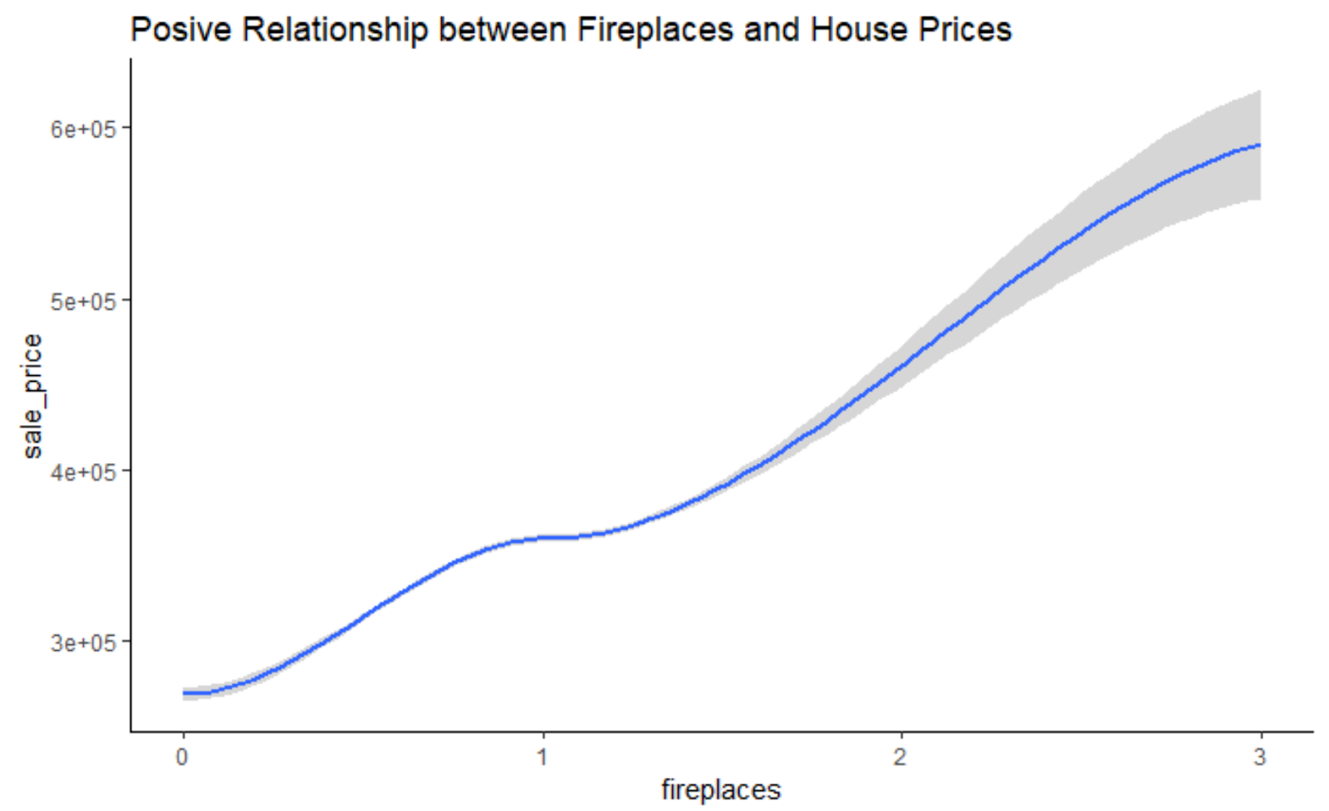
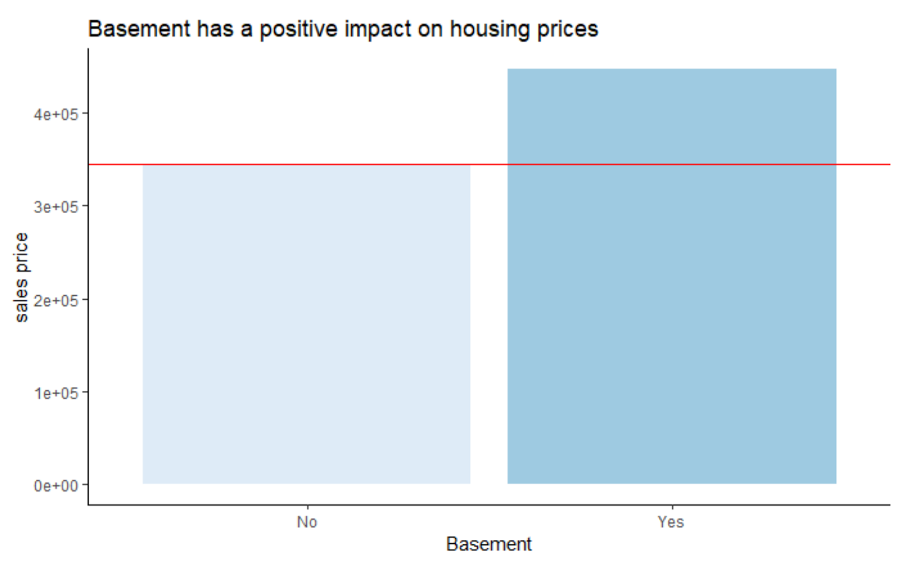
Functional Space
Fireplaces
Conclusion:
Both fireplaces and basement have positive impact on house prices
Basement

Slide 33
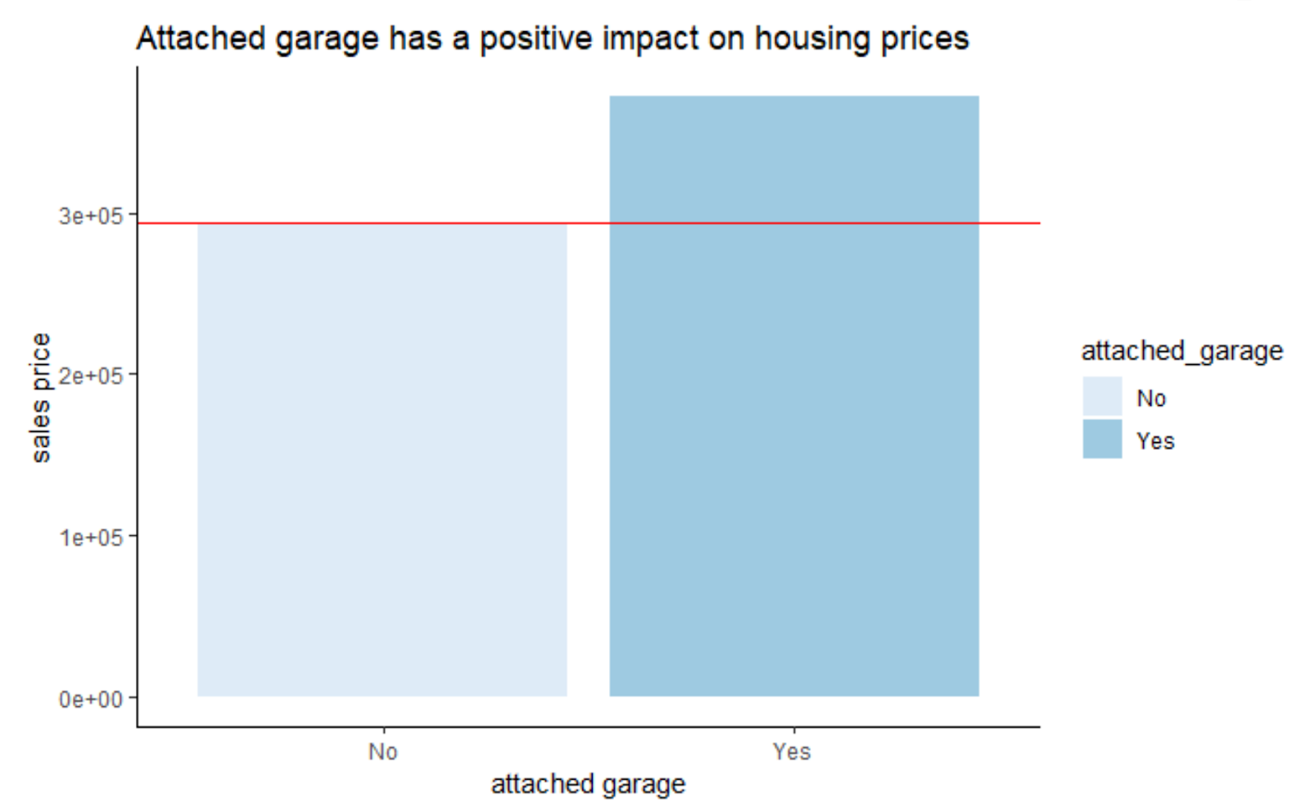
Garage
Conclusion:
1. Attached garage is more significant than detached garage
2. Attached garage has a positive impact on house prices

Slide 34
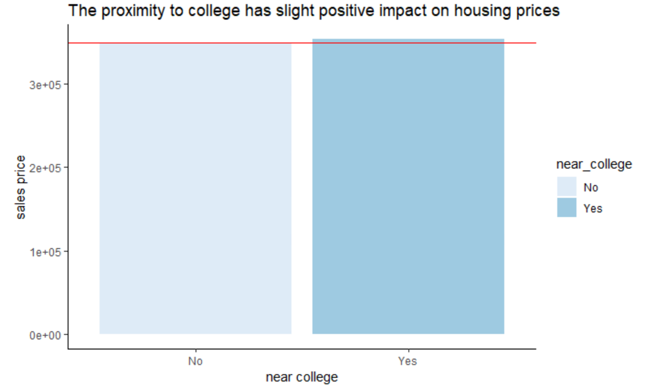
Locational Attributes
Conclusion:
There’s no apparent impact on house prices.

Slide 35
Business Impact
5

Slide 36
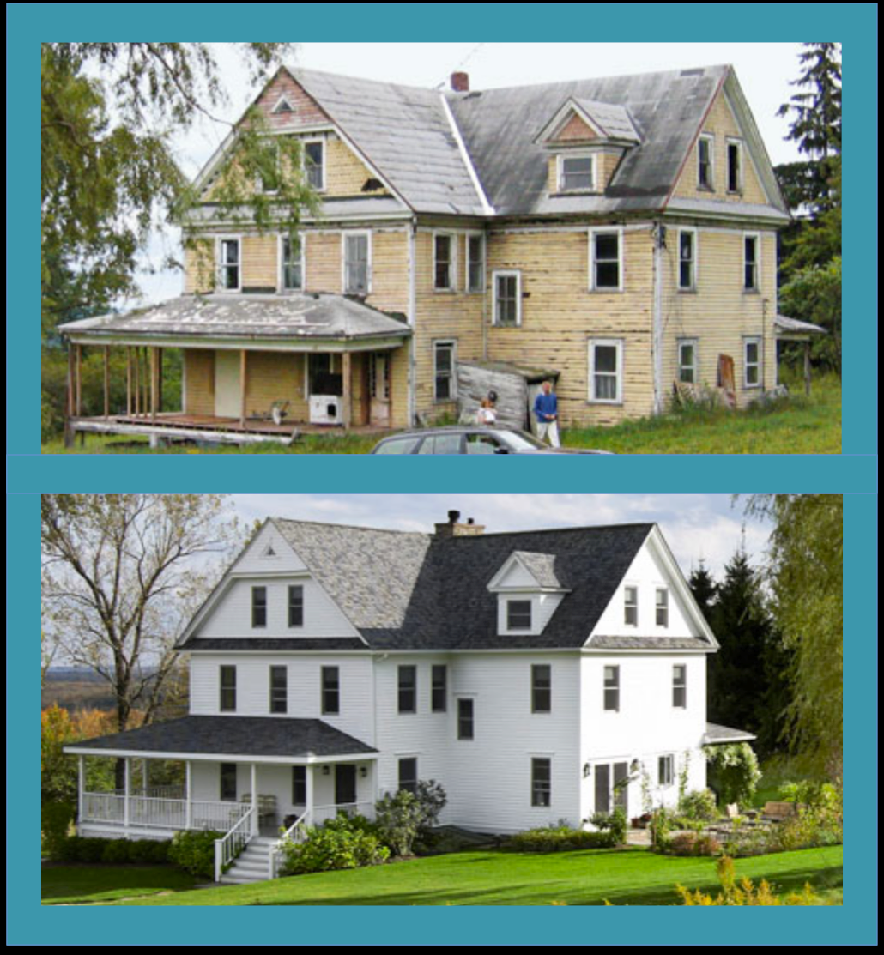
Business Impact
1. Renovation is the best way to add value
To developers, investing money in improving the “look” is most efficient way to add value to the prosperity.
Before
After

Slide 37
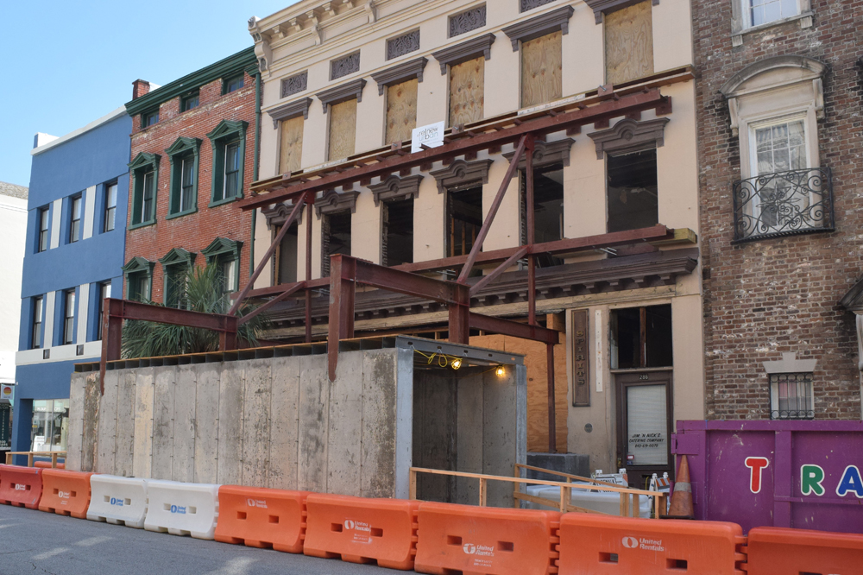

Business Impact
1. Renovation is the best way to add value
To governments, investing money in improving the building’s façade is also the most efficient way to increase the value of the community.
Before
After

Slide 38

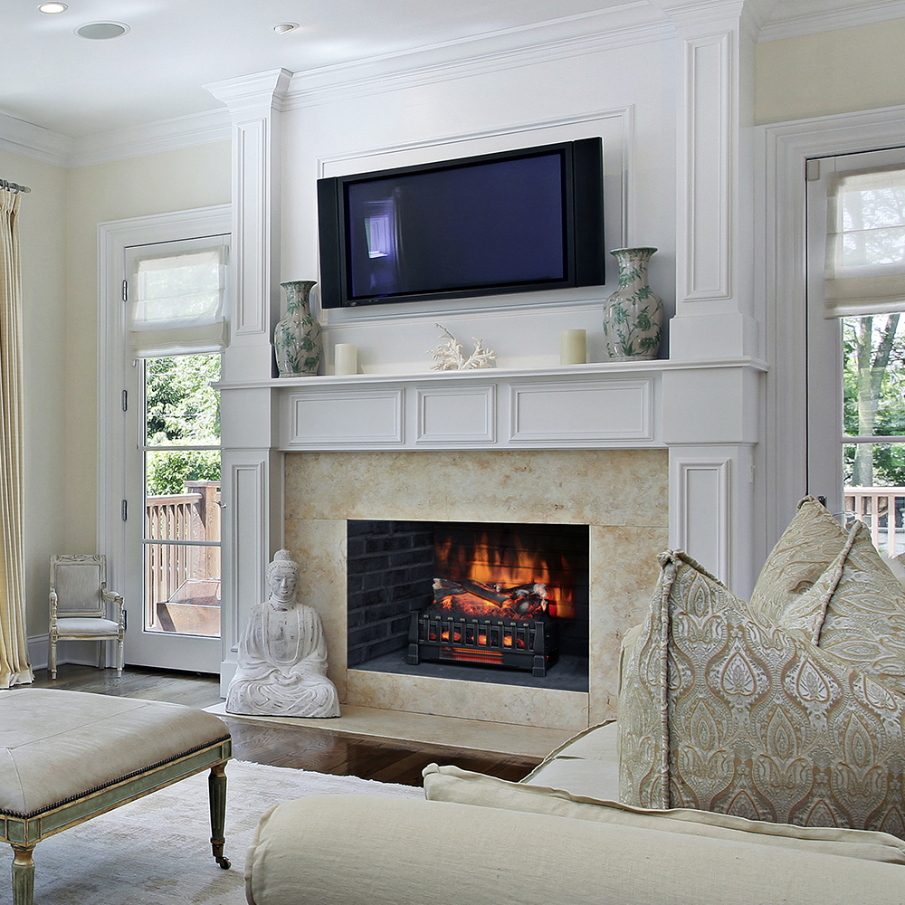

Business Impact
2. People love fireplace
Design fireplace as the central of the family space will help to increase the prosperities’ value.
Electrical Fireplace Screen
Conventional Fireplace

Slide 39
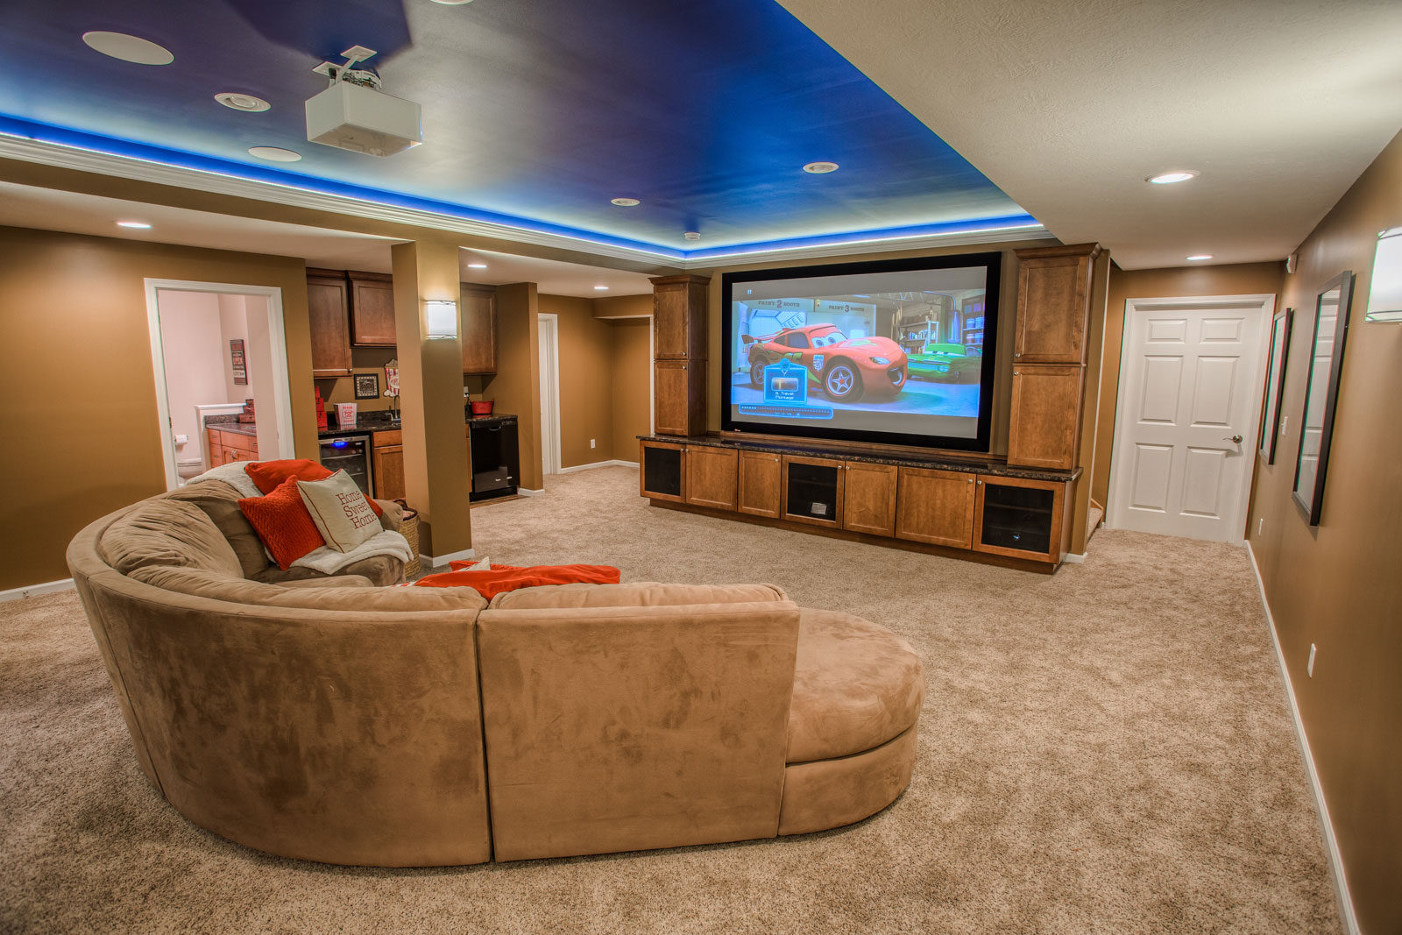

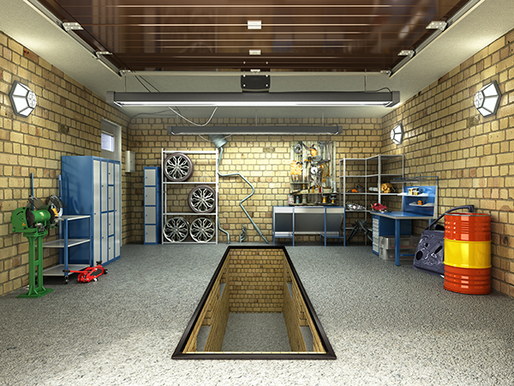
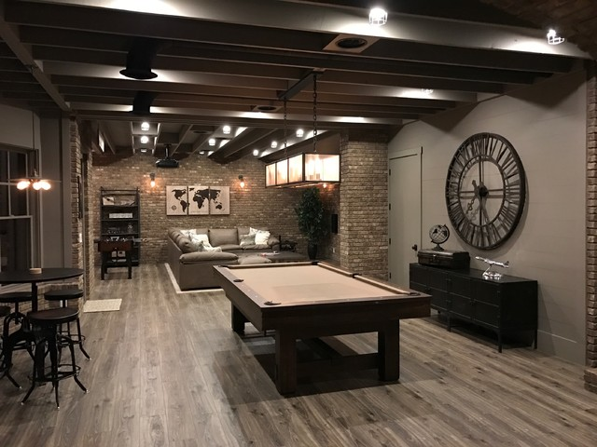
Business Impact
3. Basement allows people more choices and increase the value
The basement allow the prosperity more possibility for functions. Prosperities with basement have a higher price.
Private Movie Room
Geek Lab
Mechanical Place
Game Room

Slide 40
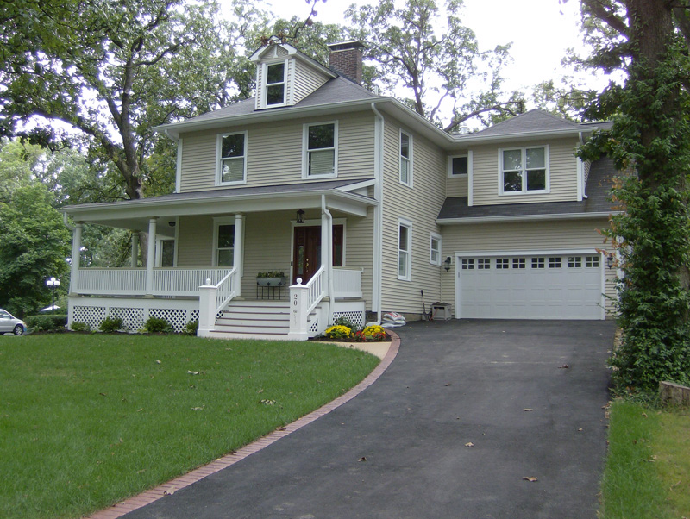
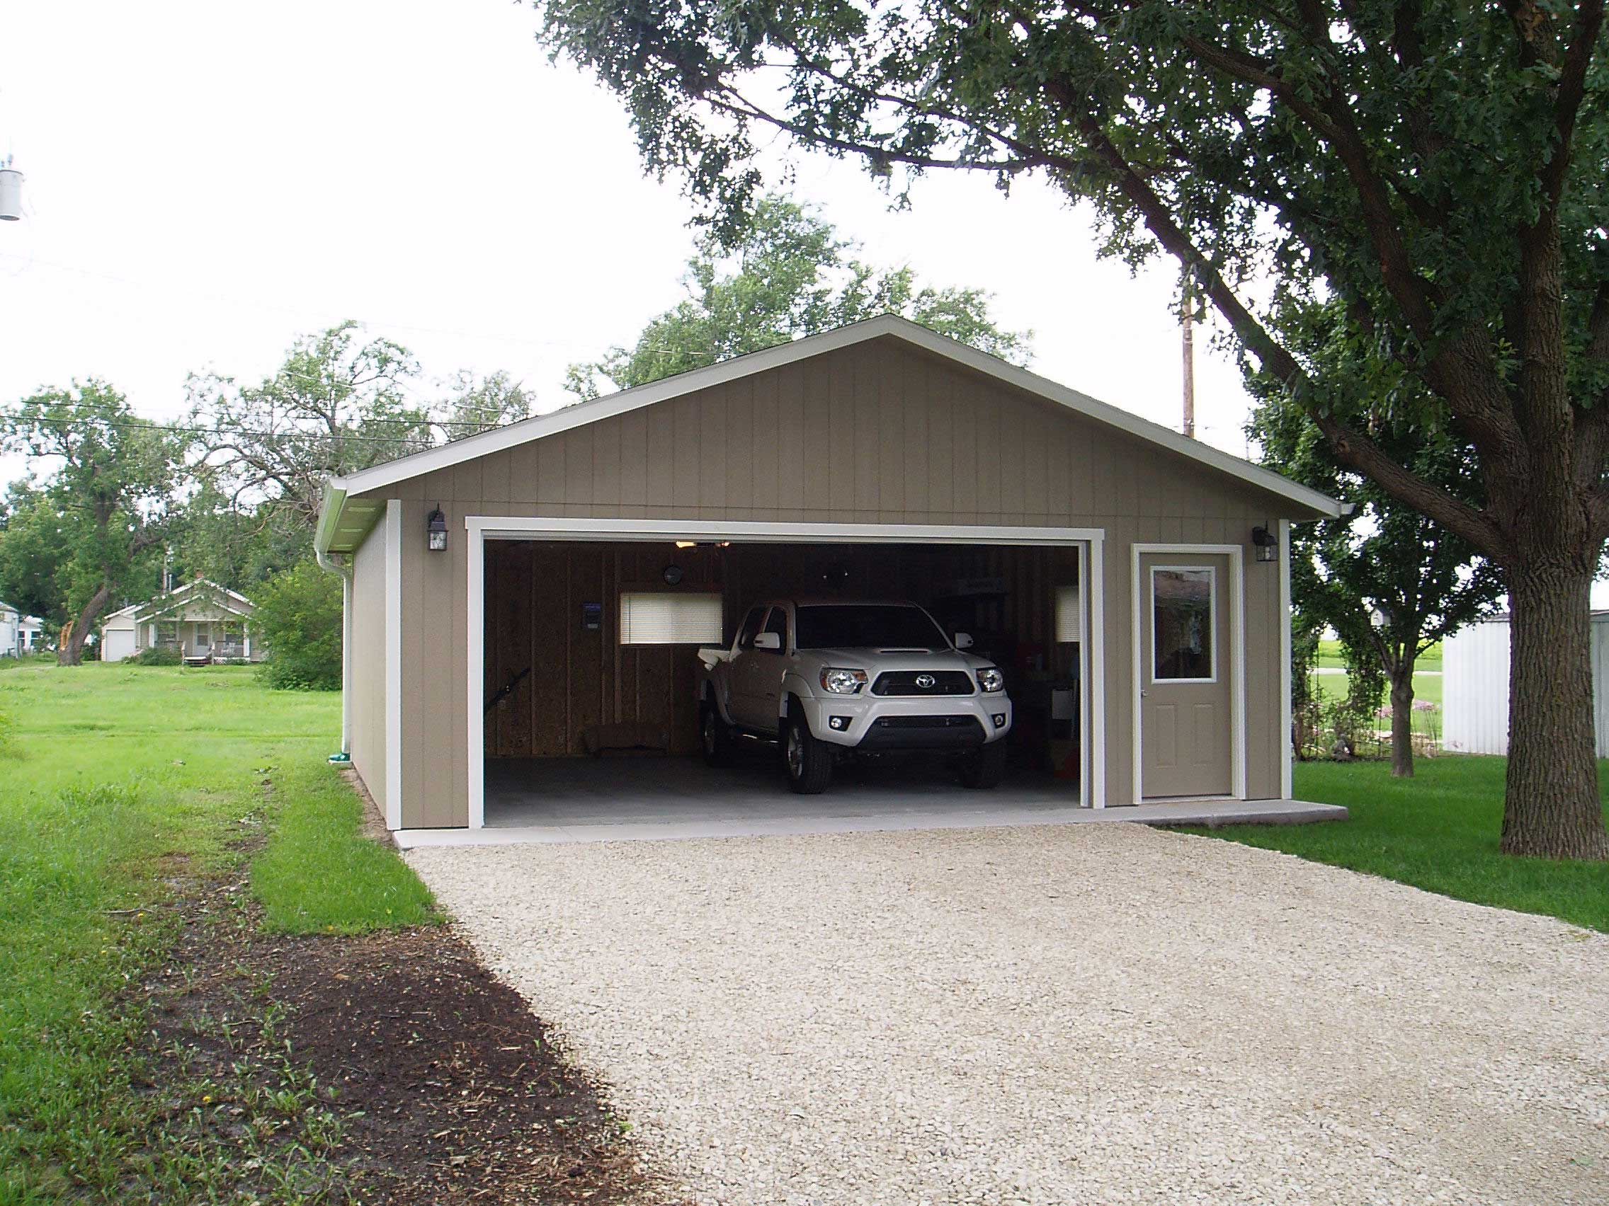
Business Impact
4. Having Attached Garage is Plus but not Detached Garage
Attached garage help to crease the prosperities’ value but not the detached garage. Even the attached and detached garage provides the same function, the continence of using the prosperity also matters.

Slide 41
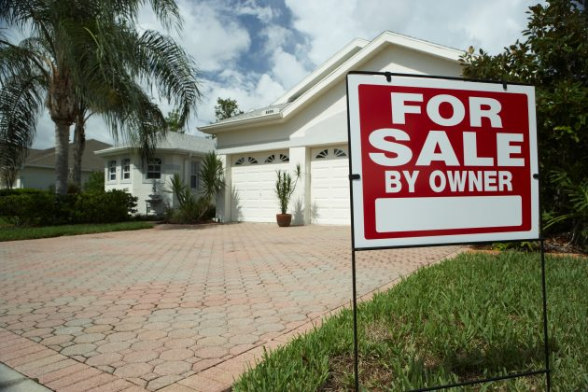

Business Impact
5. Living close to the educational facilities does not help

Slide 42
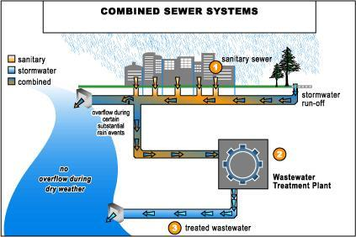
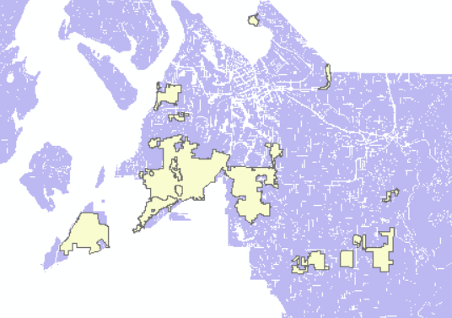
Business Impact
5. Properties in Sewer Improvement Area do not have a higher price

Slide 43
Future Study
6

Slide 44
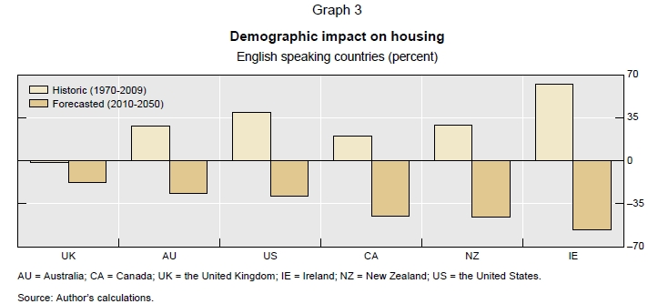
Future Study
1. Neighborhood characteristics
General population demographics in the United States
Demographic trends boosted U.S. house prices by almost 40% from 1970 – 2009
Aging will trim about 30% of house prices from 2010 - 2050

Slide 45
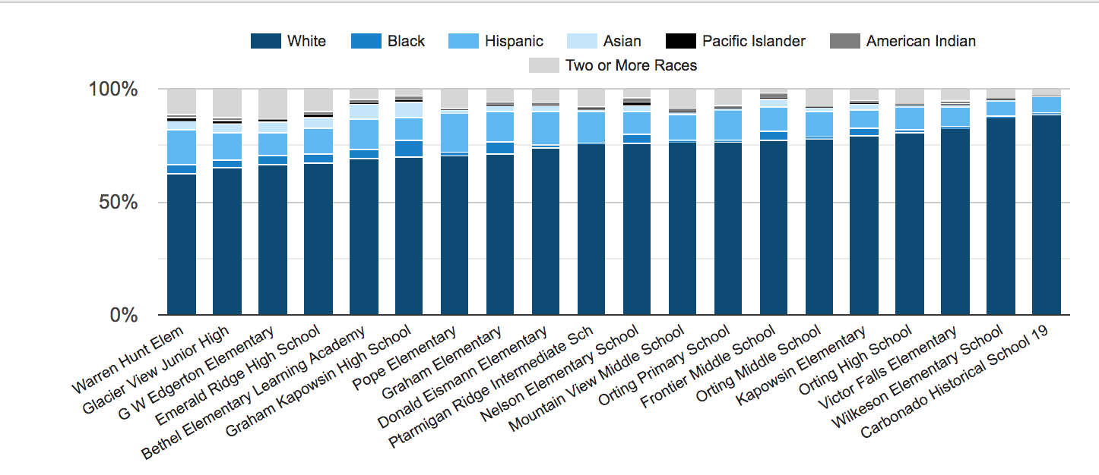
Pierce County demographic data for schools in the year 2018

Slide 46
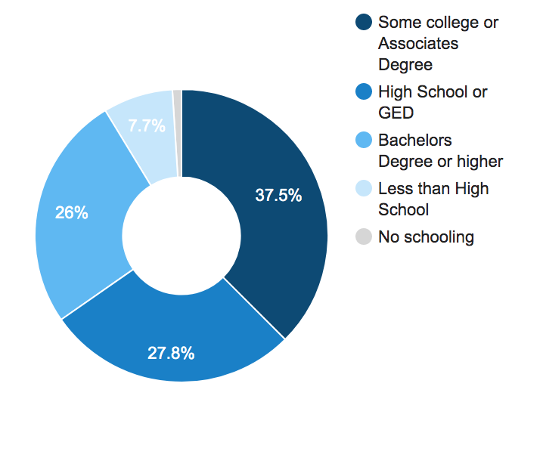
Pierce county data shows 26% of population holds a Bachelor's Degree or higher
Future Study
2. Education

Slide 47
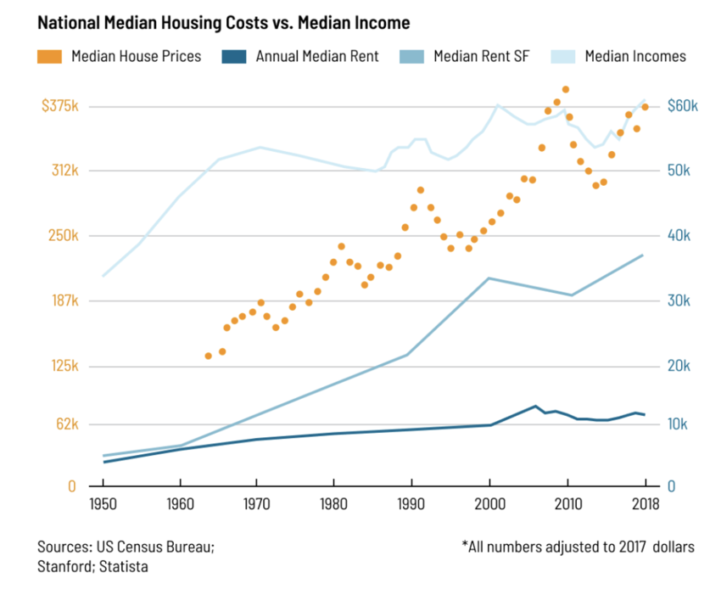
Future Study
3. Income Level
The Median household income of a Pierce County resident is $59,711 a year. The US average is $53,482 a year.
In 2013, a few years after the worst housing market crash in a century, median home prices had already risen to 3.7 times the national average.

Slide 48
Thank You
Angelica Astrom
208 555 0164
angelica@fabrikamresidences.com
www.fabrikamresidences.com

